Slide 1


Understanding University Student Mental Health
This presentation offers an in-depth analysis of mental health among university students, identifying key factors and proposing actionable recommendations for support.
by Alaya Aba

Slide 2
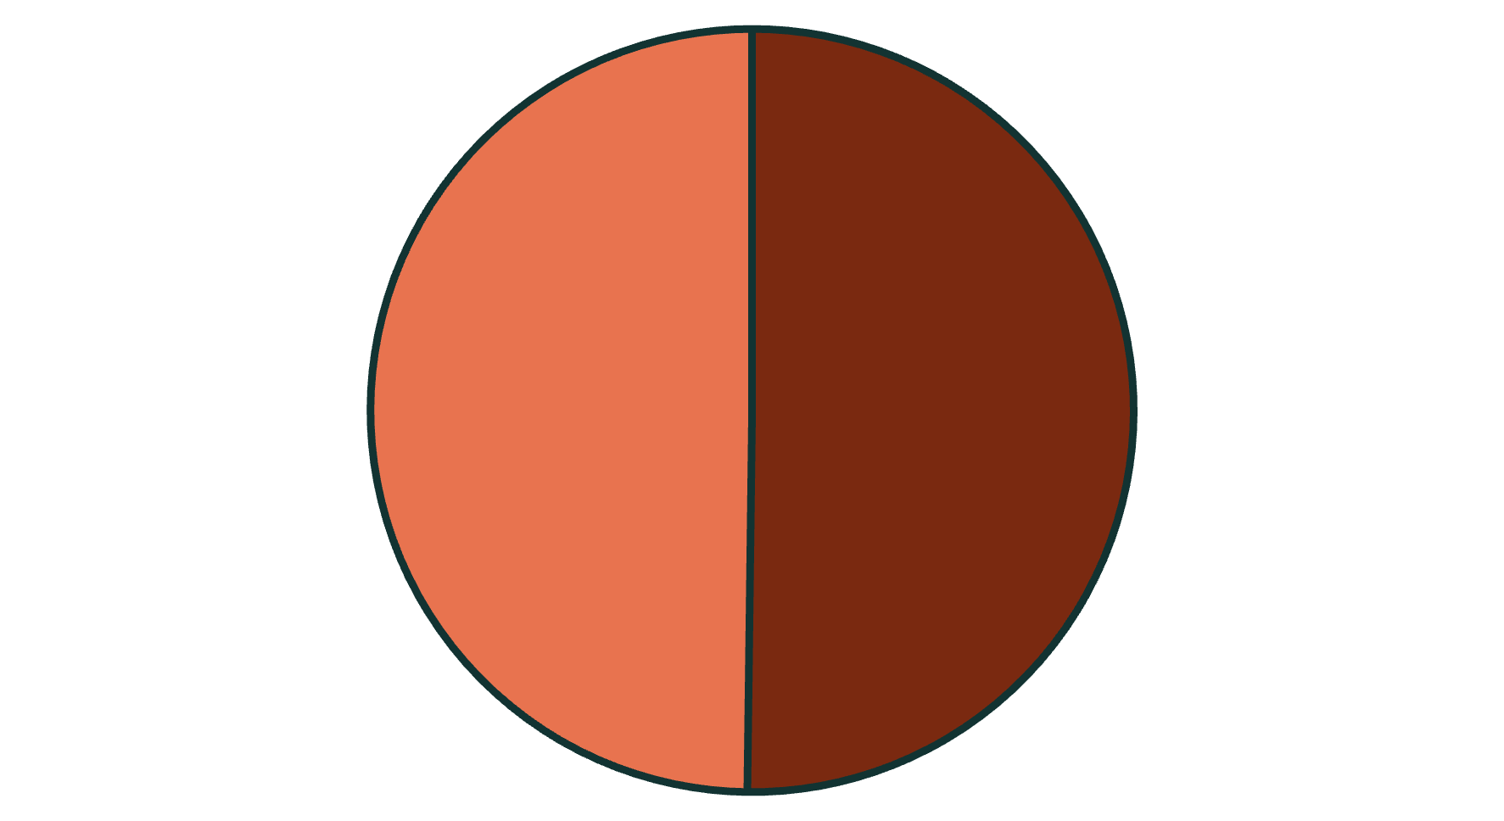
Student Population Snapshot/Executive Summary
Depressed
Not Depressed
Total of 502 students were surveyed. Almost half of students experience depression (252 students). Average age of all students is 26 years. Average study hours are 6 hours.
Total of 502 students were surveyed. Almost half of students experience depression (252). Average age of all students is 26 years. Average study hours are 6 hours.

Slide 3

Demographic Insights
53.19%
30.95%
17.46%
Male Students
Age 21-25
Age 31-35
Slightly higher male representation in survey
Highest depression rate by age group
Lowest depression rate by age group
Depression primarily impacts students aged 21-30 years (27.51% average). Male students represent the larger portion of the surveyed population, with females being 46.81%.

Slide 4
Lifestyle Factors: Sleep & Diet
Sleep Quality
Dietary Habits
7-8 & 8+ hours: Most students (25.5% for both)
Moderate: 34.26%
Less than 6 hours: 24.5% of students
Unhealthy: 33.67%
Healthy: 32.07%
Most students get adequate sleep, but dietary habits are evenly split across healthy, moderate, and unhealthy categories.

Slide 5



Lifestyle & Mental Health Link
Sleep Patterns
7-8 hours most common for depressed students (26.59%).
22.62% of those sleeping >8 hours are depressed (the least amount of people).
Dietary Habits
Unhealthy diet for 42.06% of depressed students.
Moderate and healthy diets also show depression links (32.54% and 25.40% respectively).
While many depressed students sleep 7-8 hours, unhealthy eating habits are a significant factor. Even students with healthy sleep and diet can experience depression.

Slide 6






Family History Influence
50% Depressed
Half of students with family history are diagnosed.
Family History
47.21% of students
50% Not Depressed
The other half are not diagnosed.
Nearly half of all students have a family history of mental illness. For those with a family history, depression rates are split equally.

Slide 7





Academic Pressure & Depression
Very high academic pressure impacts 83 students (the majority of students), revealing key trends.
Stress Level
Very high academic pressure.
Suicidal Thoughts
59.04% reported thoughts.
Gender Impact
54.22% are male students.
Age Group
26-35 years are most affected (28.11% average).
This group also shows unhealthy dietary habits and varied sleep patterns, with no family history of depression for the majority.

Slide 8

Study Satisfaction & Depression
63 students with very low study satisfaction are depressed, highlighting similar patterns to academic pressure.
Dietary Habits
Suicidal Thoughts
Majority have unhealthy dietary habits (38.1%).
65.08% reported suicidal thoughts.
Gender
Predominantly male students (53.97%).
This group is primarily aged 21-35 (27.51% average), with varied sleep habits (more than 8 hours - 28.57%, less than 5 hours - 26.98%, 5-6 hours - 23.81%), and most lack a family history of depression.

Slide 9





Characteristics of Non-Depressed Students
Healthy Diet
Optimal Sleep
Gender
Healthy (38.8%) or moderate (36%) dietary habits are common.
Mostly sleep more than 8 hours (28.4%) or 7-8 hours (24.4%).
Majority are male (51.6%).
Age Group
Commonly aged 21-30 years (average 29.6%).
Students not diagnosed with depression generally exhibit healthier lifestyle choices and a lower prevalence of family mental health history.

Slide 10
Key Recommendations
Targeted Campaigns
Focus mental health initiatives on male students aged 21-30.
Reduce Academic Stress
Schools should implement stress reduction strategies.
Mental Health Support
Provide workshops, helplines, and specialists.
Promote Healthy Sleep
Advise students to aim for more than 8 hours of sleep.
Optimize Study Habits
Encourage finding effective study patterns with regular breaks.
These recommendations aim to foster a supportive university environment that prioritizes student well-being.

